Slide 1


BUILDING AND HOSTING A WEBSITE USING AWS
Under the Guidance of
Mr. Gopiraju, APSSDC
Mr. Anil Kumar, APSSDC
Submitted BY
P.PAVITHRA C.VIJAYA DURGA
(214G1A3275) (214G1 A3275)

Slide 2

Presentation Elements:
➥Abstract
➥Introduction
➥AWS Services Utilized
➥Architecture/Design
➥Implementation
➥Results
➥Conclusion

Slide 3

Abstract
The project, "Creating Calculator Websites and Hosting on AWS, is an extensive guide that includes designing, deploying, and scaling web-based calculator applications on Amazon Web Services (AWS).
It starts by establishing a secure AWS infrastructure, covering VPCs, IGWs, Security Groups, and Route Tables, creating a solid foundation. Moving forward, it walks you through setting up Ubuntu servers, installing web servers, and deploying calculator applications. Network Load Balancers (NLBs) are highlighted for optimized routing and high availability, and Autoscaling is explored to dynamically adjust resources for optimal performance. Secure file transfers with WinSCP, domain registration, and robust security measures, including SSL/TLS for HTTPS, are explained.

Slide 4

Introduction :
Why Calculator Apps Matter Today?
Calculator applications have evolved into versatile tools that handle a variety of tasks, from financial calculations to scientific simulations. In our digital age, they've become indispensable.
Why AWS is for Hosting?
Amazon Web Services (AWS) provides a reliable and scalable platform for hosting these critical applications, offering security and flexibility. It's like having a super-strong, super-reliable computer in the cloud.
What This Project is All About:
How to use AWS to create, launch, and manage calculator websites. We will Use AWS services, with a particular focus on Network Load Balancers (NLBs), to ensure efficient traffic management.

Slide 5

AWS Services Utilized:
Amazon EC2 (Elastic Compute Cloud)
Amazon VPC (Virtual Private Cloud)
Internet Gateway (IGW)
Network Load Balancer (NLB)
WinSCP (Secure File Transfer Tool)
Auto Scaling

Slide 6

Abstract
Amazon EC2 (Elastic Compute Cloud):
Amazon EC2 provides the actual computing power for your calculator app. These resizable virtual servers hosts application. Set up and configure Ubuntu servers on EC2 instances, equipping them to run your calculator app.
Amazon VPC (Virtual Private Cloud):
Amazon VPC allows you to create a secure and isolated environment for your calculator app. It's like having your private corner of the AWS cloud. You'll define the network architecture, control IP addresses, and decide how traffic flows to keep your app safe.
Internet Gateway (IGW):
The Internet Gateway (IGW) is like the gateway to your calculator app's private world. It allows your app to communicate with the outside world, making it accessible to users on the internet while keeping it secure within your VPC.

Slide 7
Abstract
Network Load Balancer (NLB):
The Network Load Balancer (NLB) acts as a traffic cop for calculator application. It ensures that incoming user requests are efficiently distributed to hosting servers. This means app remains available and responsive, even during high traffic times.
WinSCP (Secure File Transfer Tool):
Although not an AWS service, WinSCP is a handy tool for managing files and configurations on EC2 instances securely. It plays a critical role in securely transferring files to and from hosting environment, ensuring calculator app stays up to date and secure.
Auto Scaling:
Auto Scaling is your app's secret to handling changes in user demand. It automatically adjusts the number of EC2 instances in your application's group. This means that during busy times, it adds more servers, and during quieter times, it scales down to save costs while maintaining availability.

Slide 8

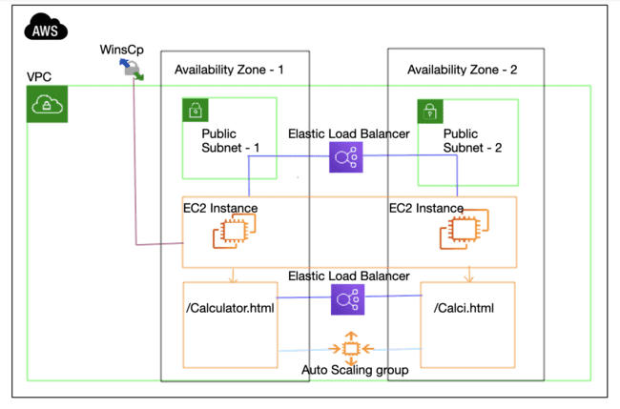
Architecture/Design:

Slide 9

Abstract
A Cloud Computing Architecture with elastic load balancing. The elastic load balancing is responsible for balancing the load between the two availability zones. The two availability zones are located in different regions, so this architecture is highly available.
The architecture is as follows:
AWS: Amazon Web Services is the cloud computing platform that provides the services used in this architecture.
WinSCp: This is the Windows Server Control Panel, which is used to manage the EC2 instances.
VPC: Virtual Private Cloud is a logical isolation of resources in AWS.
Availability Zone: An Availability Zone is a region within an AWS Region. It is a separate data center with its own power, cooling, and network infrastructure.

Slide 10
Abstract
Public Subnet: A public subnet is a subnet that is accessible from the internet.
Elastic Load Balancer: An Elastic Load Balancer is a service that distributes traffic across multiple EC2 instances.
EC2 Instance: An EC2 instance is a virtual machine that runs on AWS.
Auto Scaling group: An Auto Scaling group is a group of EC2 instances that are automatically scaled up or down based on demand.

Slide 11

Implementation:
Steps involved in this project :
Build Calculator websites using HTML,JS,CSS
Setting Up a Virtual Private Cloud (VPC)
Create two subnets
Create IGW and attach to VPC
Installing and Configuring Web Servers (e.g., Apache)
Setting Up a Network Load Balancer
Hosting websites using WINSCP
Implementing Auto Scaling Policies
Deploying Calculator Websites and Application Code

Slide 12

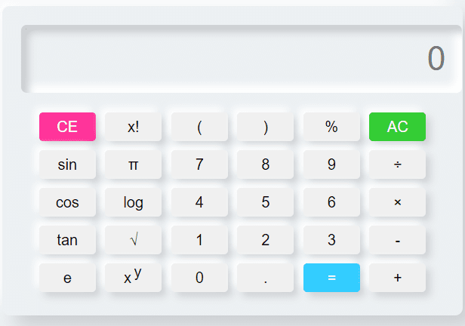
Building Websites
Building websites involves creating web content using HTML, CSS, and JavaScript, and hosting it on a server for online access.

Slide 13

Setting Up a Virtual Private Cloud (VPC):Create a secure network environment to host your web applications and resources.
Creating Two Subnets: Divide your VPC into two isolated segments to enhance security and control.
Creating an Internet Gateway (IGW) and Attaching to VPC: Establish connectivity to the internet, allowing traffic in and out of your VPC.
Creating Route table:Route tables are a foundational element of networking that ensures data is routed correctly, securely, and efficiently within a network or across multiple networks. They provide the infrastructure needed for connectivity, scalability, security, and adaptability in modern network environments.
Installing and Configuring Web Servers (e.g.Apache):Set up web server software to serve your website's content.

Slide 14
Setting Up a Network Load Balancer: Implement a load balancer to distribute incoming traffic among multiple servers for high availability.
Hosting Websites Using WinSCP: Streamline the process of transferring website files securely to your servers.
Implementing Auto Scaling Policies: Configure automatic scaling of server resources based on traffic fluctuations to ensure optimal performance.
Deploying Calculator Websites and Application Code: Upload your calculator website code and data to the servers for online access.

Slide 15
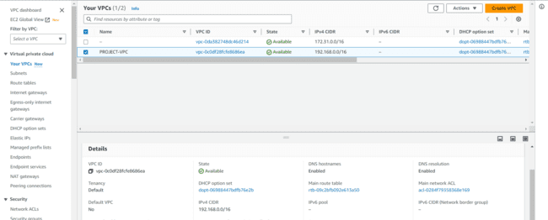
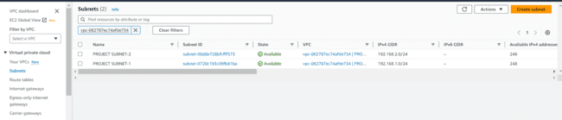
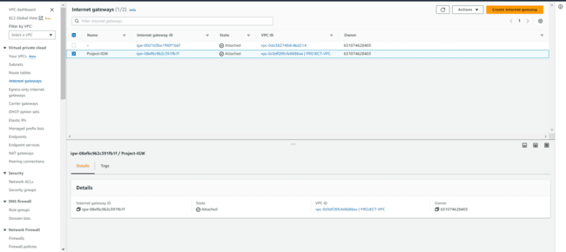
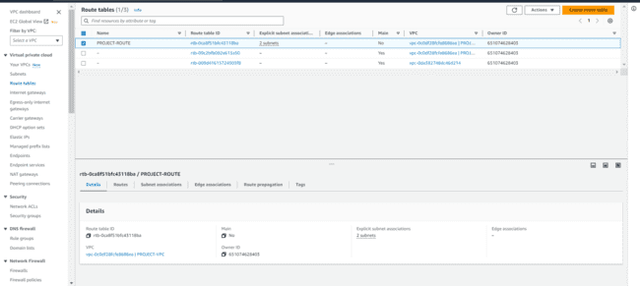
Setting up a VPC:
VPC SUBNETS
IGW ROUTE TABLE

Slide 16
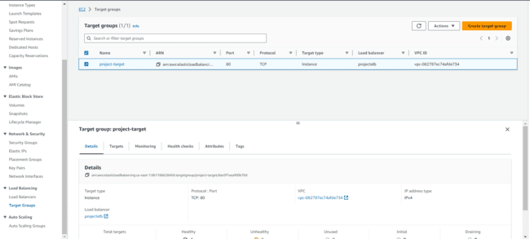
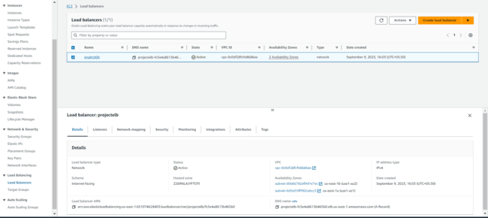
Creating Load Balancer:
Target group Network Load Balancer

Slide 17
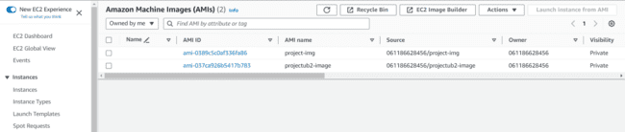
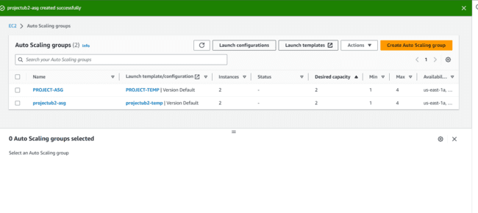
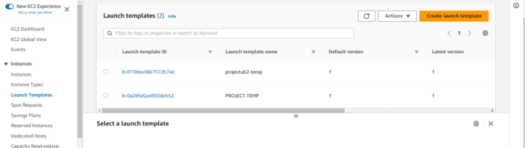
Implementing Autoscaling:
AMI’s Autoscaling groups
Templates launched

Slide 18
Results:
In our project, we witnessed substantial performance enhancements, validated through performance metrics. Scalability testing demonstrated the application's adaptability to varying traffic levels, thanks to Auto Scaling. High availability assurance and fault tolerance capabilities ensured uninterrupted service. Load balancers efficiently managed traffic distribution.
Cost savings were realized during low-traffic periods, maintaining robust security and compliance. Real-world adaptability showcased the system's resilience. We're future-ready with scalability and optimization opportunities. The implementation of Auto Scaling and load balancing had a positive impact on performance and efficiency, highlighting our architecture's effectiveness."

Slide 19
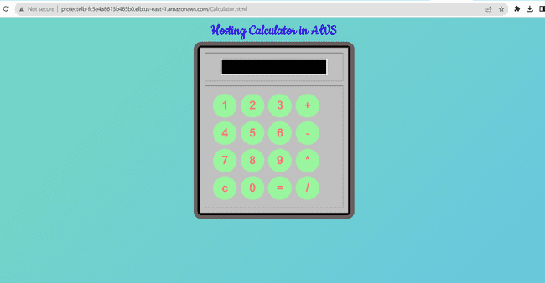
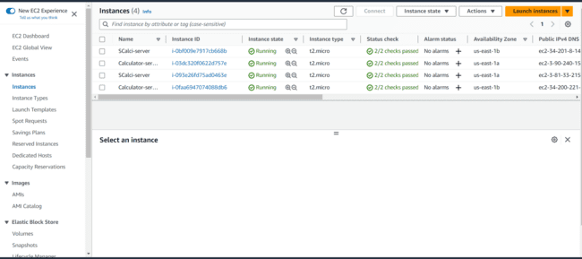
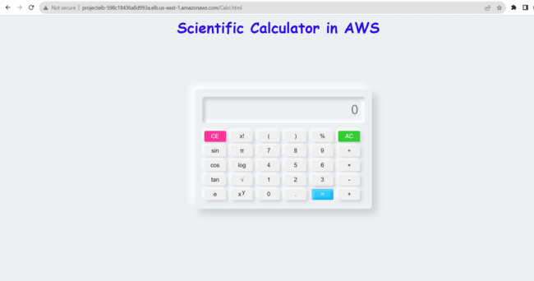
Outputs:
Hosting websites: Servers after creating ASG:

Slide 20

Conclusion:
In this project, we've explored the powerful synergy of cutting-edge technologies, including WinSCP, Network Load Balancer, VPC, Ubuntu servers, and AutoScaling, all within the AWS ecosystem. Our focus has been on creating web hosting environments that excel in scalability, security, and efficient traffic management. WinSCP has streamlined file transfers, while Network Load Balancers have optimized traffic distribution, ensuring enhanced performance and reliability, even during traffic spikes.
We've also underscored the significance of robust infrastructure design within the secure and isolated environment provided by the Virtual Private Cloud (VPC). Ubuntu servers have illustrated the versatility and cost-effectiveness of open-source solutions, while AutoScaling has ensured efficient resource utilization. In conclusion, our journey emphasizes the importance of continuous improvement, monitoring, and adaptation in the ever-evolving digital landscape.

Slide 21

THANK YOU

